Slide 1
Term project: Students’ Performance EDA
Mohammed majjaj
DSC530-T303 Data Exploration and Analysis (2213-1)

Slide 2
Introduction:
Exploratory data analysis (EDA) is an approach to analyzing data sets to summarize their main characteristics, often with visual methods. A statistical model can be used or not, but primarily EDA is for seeing what the data can tell us beyond the formal modeling or hypothesis testing task. The goal from this term project for me is to apply. I choose the students’ performance data sets for this project. The Content of This project’s would be my application of the skills I am learning through this class to perform an EDA on a data set. The goal is to analyze and discuss Students’ Performance using various visualization techniques in Python. The dataset used in this project was taken from: https://www.kaggle.com/spscientist/students-performance-in-exams

Slide 3
Research questions
Identify the variables used in this study, is there any data cleaning or variable modification needed?
Explore the dataset for a quick exploratory analysis. central tendency and measures of dispersion?
Most students are part of which ethnic group?
What is the distribution of students’ overall performance in Math, Reading and Writing?
Which gender showed greater participation in the test preparation course?
Are students’ scores dependent on their gender? Does parental level of education influence students score?
Do children that complete the test preparation course attain higher scores?
Is there a correlation between students’ reading and writing scores?
Are students’ math and writing scores correlated?
What are the variables that correlate the most with the outcome with significance?
What are the variables that explains most of the variability of the outcome with significance?
What assumptions are to be made?
model the data and prediction

Slide 4
Describing the variables in the dataset:
There are three numeric variables (math score, reading score and writing score) which show a common maximum value of 100.
Students’ scores show great variation across the three subjects but reading score has the narrowest range.
The five non-numeric variables are gender, race/ethnicity, parental level of education, lunch and test preparation course.
Dataset information:
• Dataset Characteristics: Multivariate
• Number of Instances: 1000
• Number of Attributes: 8
• three numeric variables (math score, reading score and writing score)
• five non-numeric variables are gender, race/ethnicity, parental level of education, lunch and test preparation course
• Missing Values: No
Attribute Information:
• Gender: make, female
• race/ethnicity: group B, group C, group A, group D, group E
• parental level of education: bachelor's degree, some college, master's degree, associate degree, high school, some high school
• lunch: standard, free/reduced.
• test preparation course: none, completed.
• math score: from 0 to 100
• reading score: from 0 to 100
• writing score: from 0 to 100

Slide 5
created some composites scores:
a column for variable avg Language score = (reading score + writing score) / 2
a column for variable avg score = (math score + reading score + writing score) / 3
df.head()
gender | race/ethnicity | parental level of education | lunch | test preparation course | math score | reading score | writing score | avg Language score | avg score
female | group B | bachelor's degree | standard | none | 72 | 72 | 74 | 73.0 | 72.67
female | group C | some college | standard | completed | 69 | 90 | 88 | 89.0 | 82.33
female | group B | master's degree | standard | none | 90 | 95 | 93 | 94.0 | 92.67
male | group A | associate's degree | free/reduced | none | 47 | 57 | 44 | 50.5 | 49.33
male | group C | some college | standard | none | 76 | 78 | 75 | 76.5 | 76.33

Slide 6
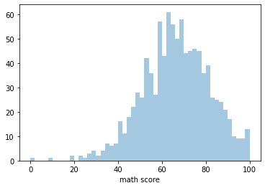
math score Histogram
Code:
sb.distplot(df['math score'], kde = False, bins=50, )
plt.show()​

Slide 7
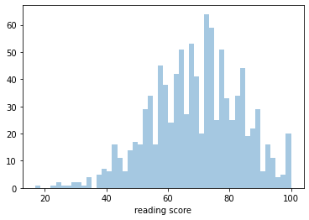
reading score Histogram
Code:
sb.distplot(df['reading score'], kde = False, bins=50, )
plt.show()​

Slide 8
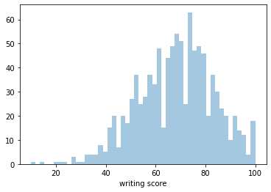
writing score Histogram
code
sb.distplot(df['writing score'], kde = False, bins=50, )
plt.show()​

Slide 9
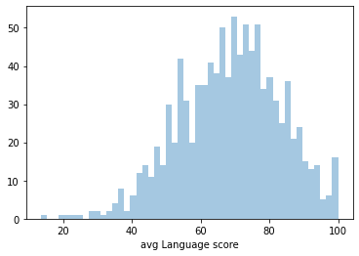
avg Language score Histogram
code
sb.distplot(df['avg Language score'], kde = False, bins=50, )
plt.show()​

Slide 10
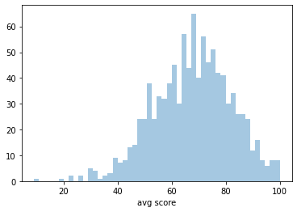
avg score Histogram
code
sb.distplot(df['avg score'], kde = False, bins=50, )
plt.show()​

Slide 11
Outliers and characteristics about the variables: Mean, Mode, Spread, and Tails
An outlier is a data point that comes from a distribution different from the bulk of the data. In the real world. in our data we see a consistent few data points where the score is below 25 and away from the bulk of the data around 40 and 90.
they are legitimate observations that accurately describe the few students that scored low in some subject. it will need more analysis to understand the why and if there is any correlation with other variables in this study.
Mean: we can see that the average student scored in the sixties point, in this order from highest to lowest. reading score, writhing then math score. we can see that the average student scored higher in avg language score then math score. and the over all avg score is 67.77
Mode: the most frequest score in math is 65 the most frequest score in reading is 72 the most frequest score in writing is 74 the most frequest score in avg Language are 67, 73, and 75.5 the most frequest score in over all avg score is 68
spread: we can see that the spread is very hight the diffrence between max and min value for math as an example is 100 point. we can see that across all variables the spread is hight and the Standard variation confirm this observation.
histograms shape and tails: all variable's histograms above has a bell-shaped picture, usually presents a normal distribution. with some skewness to the left where large number of occurrences in the upper value cells (right side) and few in the lower value cells (left side).

Slide 12
Code:
describe = df[['math score','reading score','writing score', 'avg Language score', 'avg score']].describe(include='all’)
m=df['math score'].mode()
r=df['reading score'].mode()
w=df['writing score'].mode()
al=df['avg Language score'].mode()
a=df['avg score'].mode()
new_row = pd.Series(data={'math score':m, 'reading score':r, 'writing score':w, 'avg Language score':al, 'avg score':a}, name='mode’)
​
describe= describe.append(new_row, ignore_index=False)​
describe
 | math score | reading score | writing score | avg Language score | avg score
count | 1000 | 1000 | 1000 | 1000 | 1000
mean | 66.089 | 69.169 | 68.054 | 68.6115 | 67.7706
std | 15.1631 | 14.6002 | 15.1957 | 14.7279 | 14.2573
min | 0 | 17 | 10 | 13.5 | 9
25% | 57 | 59 | 57.75 | 58.5 | 58.33
50% | 66 | 70 | 69 | 69.5 | 68.33
75% | 77 | 79 | 79 | 79 | 77.67
max | 100 | 100 | 100 | 100 | 100
mode | 0 65 | 0 72 | 0 74 | 0 67.0 1 73.0 2 75.5 | 0 68.0

Slide 13
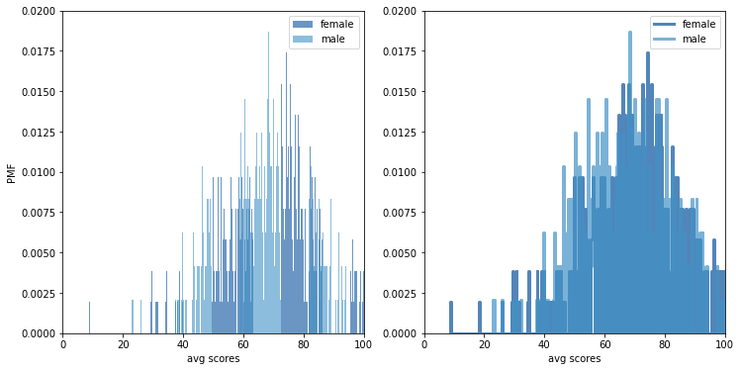
comparing the over all avg score between female and male: calculating the PMF for avg score female and male
In [187]:
female = df[df['gender'] == 'female']male = df[df['gender'] == 'male’]
​female_pmf = think.Pmf(female['avg score'], label='female’
male_pmf = think.Pmf(male['avg score'], label='male
width=0.20
axis = [0,100, 0, 0.020]thinkplot.PrePlot(2, cols=2)
thinkplot.Hist(female_pmf, align='right', width=width)
thinkplot.Hist(male_pmf, align='left', width=width)
thinkplot.Config(xlabel='avg scores', ylabel='PMF', axis=axis)​
thinkplot.PrePlot(2)thinkplot.SubPlot(2)thinkplot.Pmfs([female_pmf, male_pmf])
thinkplot.Config(xlabel='avg scores', axis=axis)
we can see that from the chart that female are less likely to score lower then 60. and somewhat more likely to score higher than male.

Slide 14
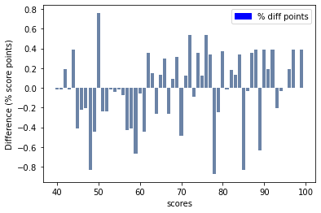
next I will chart the difference in score between the two groups to clearly visualize the difference
scores = range(40, 100)
diffs = []
for score in scores:
p1 = female_pmf.Prob(score)
p2 = male_pmf.Prob(score)
diff = 100 * (p1 - p2)
diffs.append(diff)​
import matplotlib.patches as mpatches
thinkplot.Bar(scores, diffs)thinkplot.Config(xlabel='scores', ylabel='Difference (% score points)’)
red_patch = mpatches.Patch(color='blue', label='% diff points’)
plt.legend(handles=[red_patch])​
this chart shows the difference in percentage point between the two Pmfs (female_pmf and male_pmf). it chows the result as bar chart, it makes the pater clearer: female are less likely to score lower then 60. and somewhat more likely or to score higher than male.

Slide 15
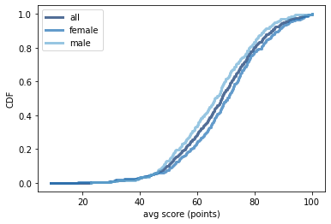
calculating the CDF for avg score for all class then female and male separately for comparison.
cdf_all = think.Cdf(df['avg score'], label='all’)
cdf_female = think.Cdf(female['avg score'], label='female’)
cdf_male = think.Cdf(male['avg score'], label='male’)
​thinkplot.PrePlot(3)
thinkplot.Cdfs([cdf_all, cdf_female, cdf_male])
thinkplot.Config(xlabel='avg score (points)', ylabel='CDF')
this figure makes the shape of the distributions, and the differences between the different groups apparent. we can see that the scores for male are consistently lower through out the distributions after 50 average score point.

Slide 16
calculating the fraction of scores less then 50 and 80 for the three groups
¶
In [217]:
% of scores less then 50
all : 10.9
female : 8.494208494208493
male : 13.485477178423237
% of scores more 80
all : 19.39999999999999
female : 22.200772200772207
male : 16.390041493775925
analysing the fraction of scores less than 50:
we can see that over all 11% of the average scores are less than or equal to the passing point 50.
only 8.5% for female
and increases to 13.5% for males
analysing the fraction of scores lmore then 80:
we can see that over all 19% of the average scores are more then 80.
only 16% for male
and increases to 22% for females
print('% of scores less then 50’)
print('all : ' + str(cdf_all.Prob(50)*100))
print('female : ' + str(cdf_female.Prob(50)*100))
print('male : ' + str(cdf_male.Prob(50)*100))
#---------------
print(‘’)
print('% of scores more 80’)
print('all : ' + str(100-cdf_all.Prob(80)*100))
print('female : ' + str(100-cdf_female.Prob(80)*100))
print('male : ' + str(100-cdf_male.Prob(80)*100))

Slide 17
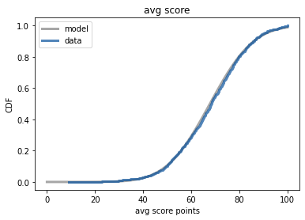
below code will compare a model of a normal CDF to our Data average score CDF
# calculating the mean and variance of the data average score
mu, var = think.MeanVar(df['avg score’])
print('Mean, Var', mu, var)
# plot the model
sigma = np.sqrt(var)
print('Sigma', sigma)xs, ps = think.RenderNormalCdf(mu, sigma, low=0, high=100)
​thinkplot.Plot(xs, ps, label='model', color='0.5’)
​# plot the data
cdf = think.Cdf(df['avg score'], label='data')​thinkplot.PrePlot(1)thinkplot.Cdf(cdf) thinkplot.Config(title='avg score', xlabel='avg score points', ylabel='CDF')
we can see that the data fits well the normal model.

Slide 18
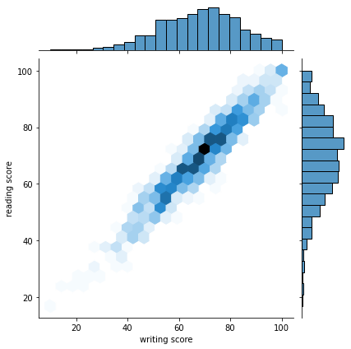
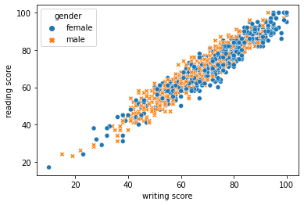
Scatter plot of writing and reading scores.
sb.jointplot(x = 'writing score',y = 'reading score',data = df,kind = 'hex’)
plt.show()
sns.scatterplot(data=df, x='writing score', y='reading score', hue='gender', style='gender')
we can see that the reading score and writing score have positive linear relationship; when a student have a high score in writing it is expected to have a high score in reading. this is true for both female and male students.

Slide 19
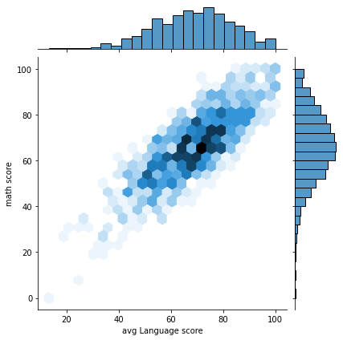
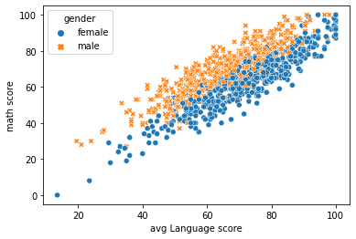
Scatter plot of avg Language score and math scores
sb.jointplot(x = 'avg Language score',y = 'math score',data = df,kind = 'hex’)
plt.show()
sns.scatterplot(data=df, x = 'avg Language score',y = 'math score', hue='gender', style='gender')
we can see that the avg Language score and math score have positive linear relationship; when a student have a high score in Language score it is expected to have a high score in math score.
there is also a distinction of the degree of the relationship. we can see that there is a clear distinction between the two genders in second graph.
for female student for a math score the corresponding language score is lower. for male student when math score is higher the corresponding language score is lower.

Slide 20
correlation matrix
Preparing the data:
newdf = df[['gender','test preparation course','math score', 'reading score', 'writing score', 'avg Language score', 'avg score', 'result']]
# label encoding for gender​# male =0# female =1​
newdf['gender']= newdf['gender'].replace(['male','female'], value=[0,1]) ​
# label encoding for test preparation course# none =0# completed = 1​
newdf['test preparation course']= newdf['test preparation course'].replace(['none','completed'], value=[0,1])
​​# label encoding for result# failed =0# passed= 1
​newdf['result']= newdf['result'].replace(['failed','passed'], value=[0,1])
gender | test preparation course | math score | reading score | writing score | avg Language score | avg score | result
1 | 0 | 72 | 72 | 74 | 73.0 | 72.67 | 1
1 | 1 | 69 | 90 | 88 | 89.0 | 82.33 | 1
1 | 0 | 90 | 95 | 93 | 94.0 | 92.67 | 1
0 | 0 | 47 | 57 | 44 | 50.5 | 49.33 | 0
0 | 0 | 76 | 78 | 75 | 76.5 | 76.33 | 1

Slide 21
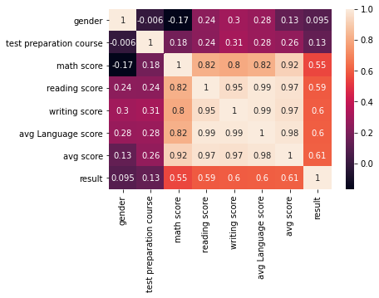
correlation matrix
sns.heatmap(newdf.corr(),annot=True)
​import scipy.stats as stats
print(stats.pointbiserialr(newdf['math score'],newdf['gender’]))
print(stats.pointbiserialr(newdf['avg score'],newdf['test preparation course’]))
print(stats.pointbiserialr(newdf['math score'],newdf['result']))​
PointbiserialrResult(correlation=-0.16798223810035565, pvalue=9.120185549328867e-08) PointbiserialrResult(correlation=0.25671500947104037, pvalue=1.6313729799656816e-16) PointbiserialrResult(correlation=0.5494596342331253, pvalue=5.948462615180441e-80)
we can see from this correlation map that:
gender female has a negative point biserial correlation with Math score which we already have noticed from scatter plot above
test preparation course has a positive point biserial correlation with average score and suggest that student that conducted preparing have positive results
the writing score has strong positive correlation with reading score.
the math score has a strong positive correlation with writing and reading score but has a stronger correlation with avg score.
average score has a positive correlation from strongest to less strong, language score, math score, test preparation, and gender.

Slide 22
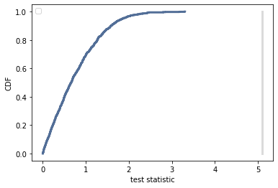
Conducting a hypothesis test
test the assumption we made earlier that student gender affect the Math score. will be using as a test statistic the difference in means between both groups.
our null hypothesis is that the apparent affect is not real (gender do not affect math score).
data = male['math score'].values, female['math score'].values
class DiffMeansPermute(think.HypothesisTest):​
def TestStatistic(self, data):
group1, group2 = data
test_stat = abs(group1.mean() - group2.mean()) return
test_stat​
def MakeModel(self):
group1, group2 = self.data
self.n, self.m = len(group1), len(group2)
self.pool = np.hstack((group1, group2))​
def RunModel(self):
np.random.shuffle(self.pool)
data = self.pool[:self.n],
self.pool[self.n:]
return data
The reported p-value is 0 (statistically significant). which means that in 1000 trials we didn't see a difference in score mean between the two groups, under the null hypothesis, that exceeded the observed difference. That means that the p-value is probably smaller than 1/1000 , but it is not actually 0.
To get a sense of how unexpected the observed value is under the null hypothesis, we can compare the actual difference to the largest value we saw in the simulations.
#runing the test.
​ht = DiffMeansPermute(data)pvalue = ht.PValue()
Pvalue
0.0
ht.PlotCdf()thinkplot.Config(xlabel='test statistic', ylabel='CDF')

Slide 23
Regression Analysis
in this part i will try to model gender based on feature below.
df_to_model=df[['gender', 'race/ethnicity', 'parental level of education', 'test preparation course', 'math score', 'reading score', 'writing score']]
 | gender | race/ethnicity | parental level of education | test preparation course | math score | reading score | writing score
0 | female | group B | bachelor's degree | none | 72 | 72 | 74
1 | female | group C | some college | completed | 69 | 90 | 88
2 | female | group B | master's degree | none | 90 | 95 | 93
3 | male | group A | associate's degree | none | 47 | 57 | 44
4 | male | group C | some college | none | 76 | 78 | 75

Slide 24
data processing
from sklearn.preprocessing import LabelEncoder​
# creating an encoder
le = LabelEncoder()​
# label encoding for gender
df_to_model['gender'] = le.fit_transform(df_to_model['gender’])​
# label encoding for race/ethnicity​
df_to_model['race/ethnicity'] = le.fit_transform(df_to_model['race/ethnicity’])
df_to_model = df_to_model.rename(columns={"race/ethnicity":"race_ethnicity"})
​# label encoding for parental level of education​
df_to_model['parental level of education'] = le.fit_transform(df_to_model['parental level of education’])
df_to_model = df_to_model.rename(columns={"parental level of education":"parental_education_level"})
​​# label encoding for test preparation course
​df_to_model['test preparation course'] = le.fit_transform(df_to_model['test preparation course’])
df_to_model = df_to_model.rename(columns={"test preparation course":"test_preparation"})
​​​​df_to_model = df_to_model.rename(columns={"math score":"math_score"})
df_to_model = df_to_model.rename(columns={"writing score":"writing_score"})
df_to_model = df_to_model.rename(columns={"reading score":"reading_score"})
after the data processing and changed all categorical data to numbers we can do a map heat for the correlation
parental level of education :
0 associate's degree 1 bachelor's degree 2 high school 3 master's degree 4 some college 5 some high school
gender :
0 female 1 male
race/ethnicity :
0 group A 1 group B 2 group C 3 group D 4 group E
test preparation course:
0 completed 1 none

Slide 25
In [608]:
In [609]:
In [610]:
following functions will mine the variables and search for variables with explanatory power we have in the data to model the variable result it will calculate the 𝑅2R2 and sort them from highest to lowest.
import statsmodels.formula.api as smf
import patsy
def GoMining(df):
variables = []
for name in df.columns:
try:
if df[name].var() < 1e-7:
continue​
formula = 'gender ~ race_ethnicity + ' + name
model = smf.ols(formula, data=df)
if model.nobs < len(df)/2:
continue​
results = model.fit()
except (ValueError, TypeError):
continue​ variables.append((results.rsquared, name))​
return variables
gender 1.0
writing_score 0.09314596340636594
eading_score 0.0608685324566377
math_score 0.029721516288994665
test_preparation 3.892092855461993e-05
parental_education_level 5.737920306891908e-06
race_ethnicity 2.2557768403208556e-06
import patsy​
variables = GoMining(df_to_model)
import re​
def MiningReport(variables, n=30):
variables.sort(reverse=True)
for r2, name in variables[:n]:
key = re.sub('_r$', '', name)
print(name, r2)
MiningReport(variables)

Slide 26
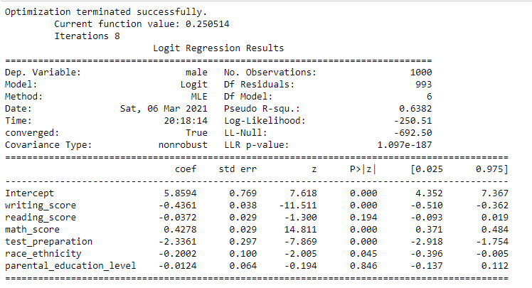
In [665]:
now we can build owr Logistic regression model to predict variable gender.
df_to_model['male'] = (df_to_model['gender']==1).astype(int) ​
import statsmodels.formula.api as smf​
formula= 'male ~ writing_score + reading_score + math_score + test_preparation + race_ethnicity + parental_education_level’
model = smf.logit(formula,data=df_to_model)
res = model.fit()
print(res.summary())​​

Slide 27
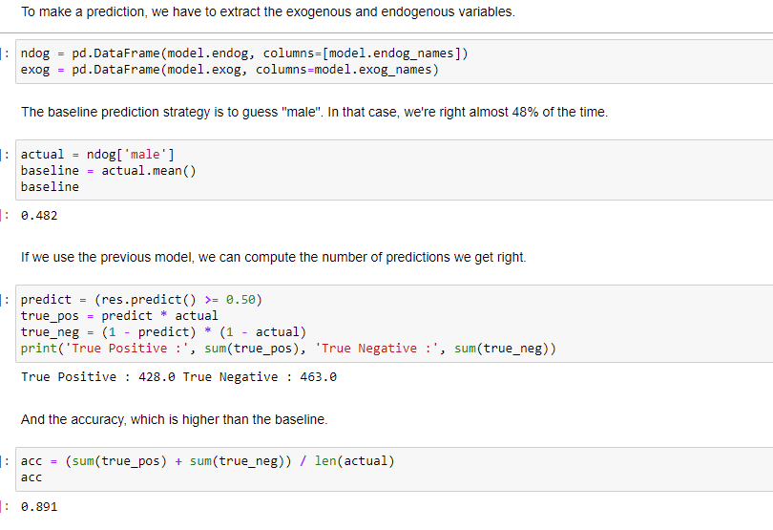

Slide 28
